Slide 1
Machine Learning AIML CZG565
M6 : Instance Based Learning
Course Faculty of M.Tech Cluster
BITS – CSIS - WILP

Slide 2

Machine Learning
Disclaimer and Acknowledgement
These content of modules & context under topics are planned by the course owner Dr. Sugata, with grateful acknowledgement to many others who made their course materials freely available online
We here by acknowledge all the contributors for their material and inputs.
We have provided source information wherever necessary
Students are requested to refer to the textbook w.r.t detailed content of the presentation deck shared over canvas
We have reduced the slides from canvas and modified the content flow to suit the requirements of the course and for ease of class presentation
Slide Source / Preparation / Review:
From BITS Pilani WILP: Prof.Sugata, Prof.Chetana, , Prof.Monali, Prof.Rajavadhana, Prof.Seetha, Prof.Anita, Prof. Swarna
External: CS109 and CS229 Stanford lecture notes, Dr.Andrew NG and many others who made their course materials freely available online

Slide 3
Course Plan
M1 | Introduction
M2 | Machine learning Workflow
M3 | Linear Models for Regression
M4 | Linear Models for Classification
M5 | Decision Tree
M6 | Instance Based Learning
M7 | Support Vector Machine
M8 | Bayesian Learning
M9 | Ensemble Learning
M10 | Unsupervised Learning
M11 | Machine Learning Model Evaluation/Comparison

Slide 4
Instance Based Learning

Slide 5
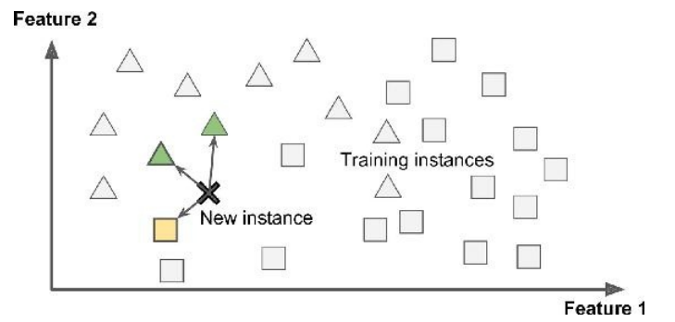
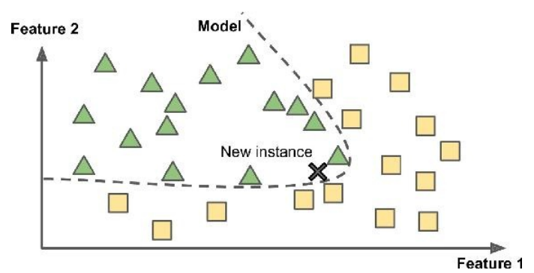
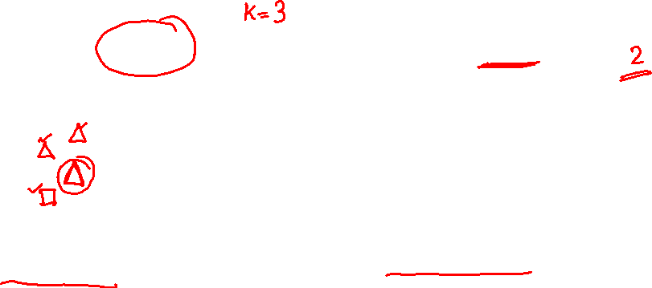
Introduction to Machine Learning
Types: Based on how & when the training data is used
Instance Based Learning: Compare new data points to known data points
Model Based learning : Detect patterns in the training data and build a predictive model
Instance Based
Model Based
Lazy Learners : Less time in training but more time in predicting
Eager Learners : More time in training but Less time in predicting

Slide 6
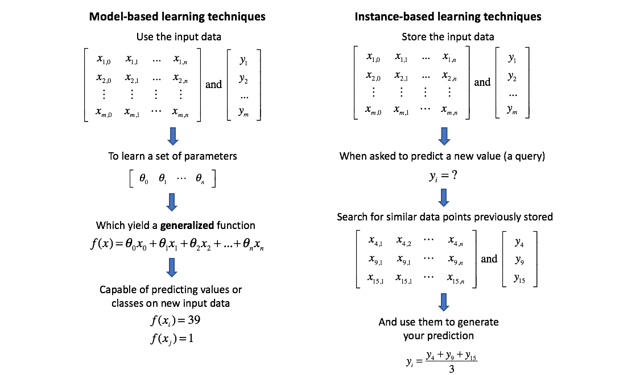
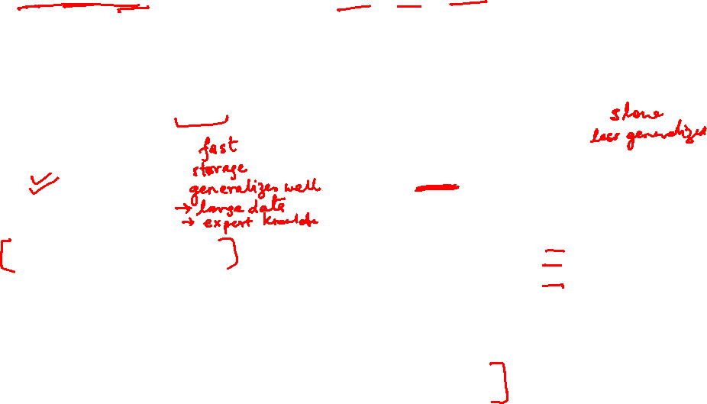
Instance Based Learning
Source Credit : https://www.jeremyjordan.me/k-nearest-neighbors/

Slide 7






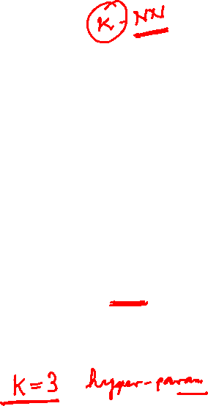
Instance Based Learning
Nearest Neighbor Approach
Basic idea:
If it walks like a duck, quacks like a duck, then it’s probably a duck
Compute Distance
Test Record
Training Records
Choose k of the “nearest” records

Slide 8
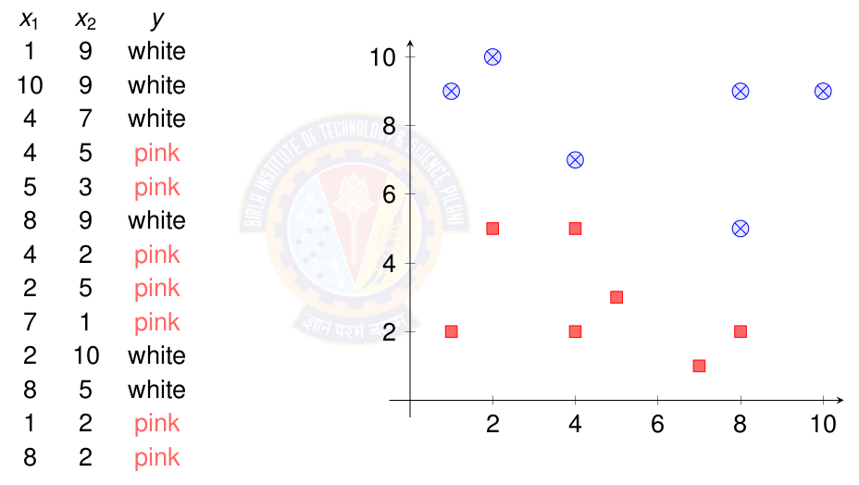
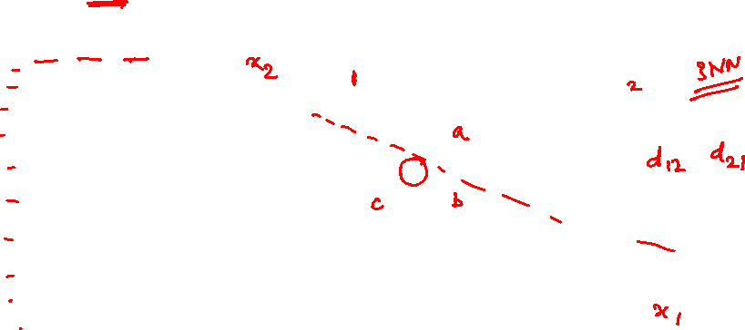
Instance Based Learning
Nearest Neighbor Approach : Notations
K-nearest neighbor:
Given x_{q}, take vote among its k nearest neighbors (if discrete-valued target function)
Take mean(or median) of f values of k nearest neighbors (if real-valued) f*(x_{q})=Σ_{i=1}^{k} f(x_{i})/k
Key idea: just store all training examples <x_{i},f(x_{i})>
Given query instance x_{q}, first locate nearest training example x_{n}, then estimate f*(x_{q})=f(x_{n})
Interpretation : Assume that the Instances represented as points in a Euclidean space

Slide 9
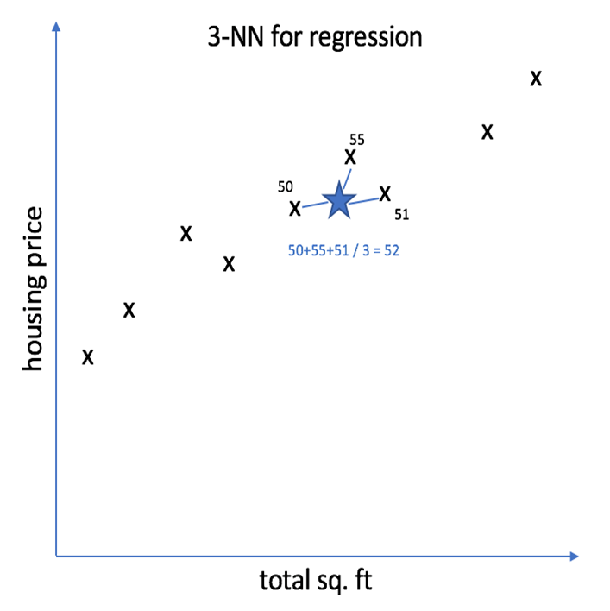
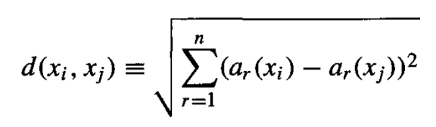
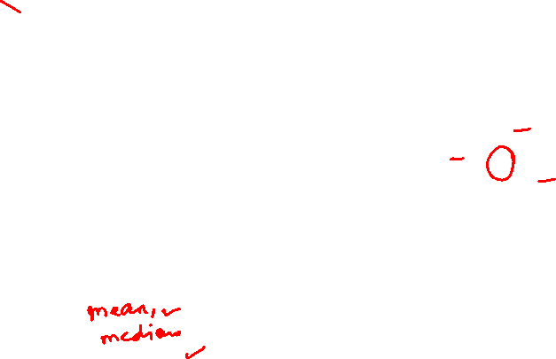
Instance Based Learning
K-Nearest Neighbor Regression: Example
Size in feet² (x) | Price ($) in 1000's (y)
2104 | 460
1416 | 232
1534 | 315
1852 | 178
… | … …
Source Credit : https://www.jeremyjordan.me/k-nearest-neighbors/

Slide 10
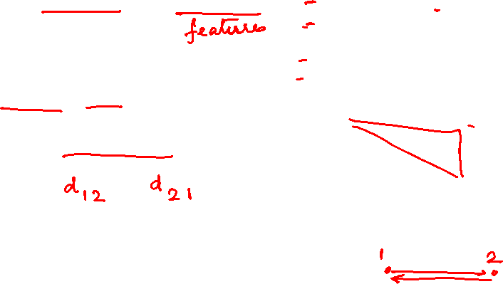
Data Matrix and Dissimilarity Matrix
Measures of Dis/similarity:
Data matrix
n data points with p dimensions
Dissimilarity matrix
n data points, but registers only the distance
A triangular matrix

Slide 11
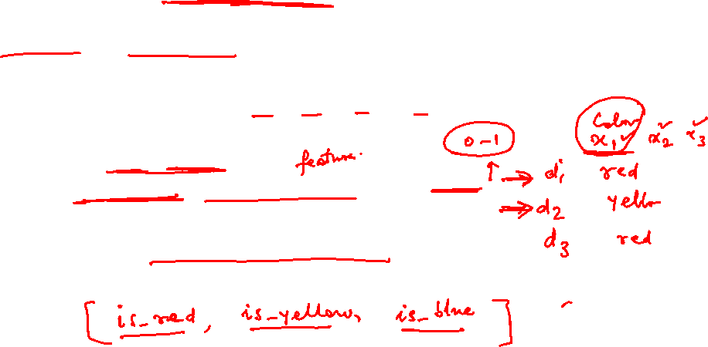
Measures of Dis/similarity:
Nominal Attributes
Can take 2 or more states, e.g., red, yellow, blue, green (generalization of a binary attribute)
Method 1: Simple matching
m: # of matches, p: total # of variables
Method 2: Use a large number of binary attributes
creating a new binary attribute for each of the M nominal states

Slide 12
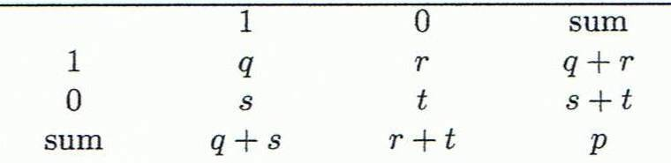
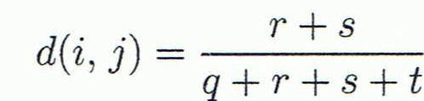
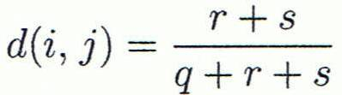
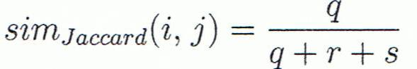
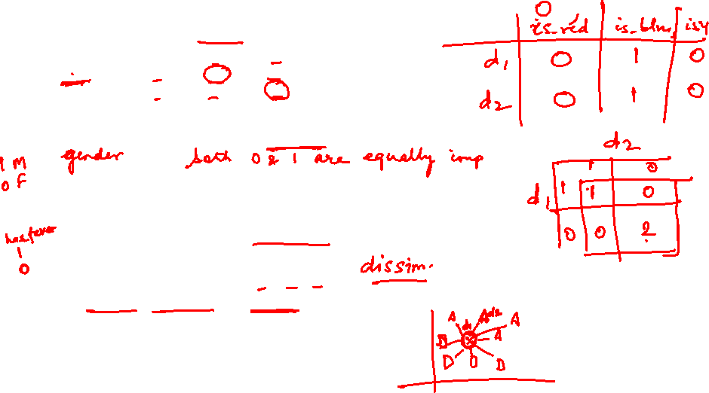
Measures of Dis/similarity:
Binary Attributes
A contingency table for binary data
Distance measure for symmetric binary variables:
Distance measure for asymmetric binary variables:
Jaccard coefficient (similarity measure for asymmetric binary variables):
Object j
Object i
Notes:
MK: I tried to change equations so as to match notation in book, but each time I try to install the equation editor, it fails! Agh!

Slide 13
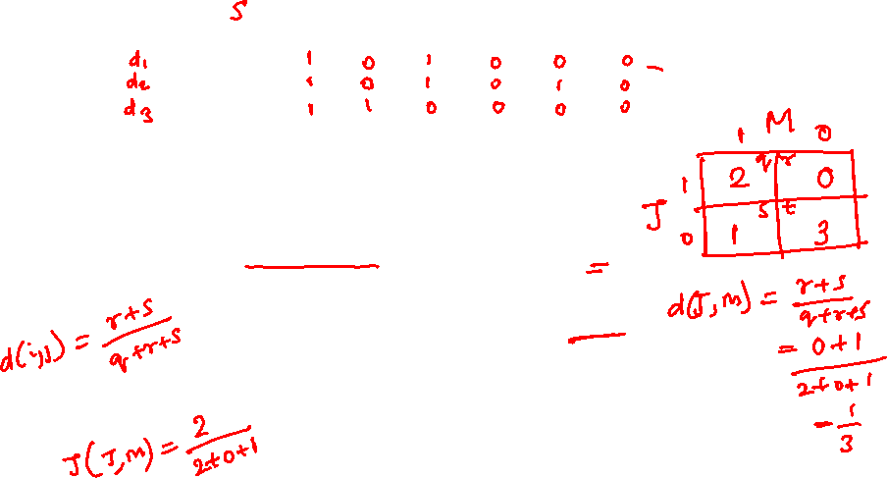
Measures of Dis/similarity:
Binary Attributes
Example
Gender is a symmetric attribute
The remaining attributes are asymmetric binary
Let the values Y and P be 1, and the value N is 0

Slide 14

Measures of Dis/similarity Distances: Minkowski Distance
Minkowski distance: A popular distance measure
where i = (x_{i1}, x_{i2}, …, x_{ip}) and j = (x_{j1}, x_{j2}, …, x_{jp}) are two p-dimensional data objects, and h is the order (the distance so defined is also called L-h norm)
Properties
d(i, j) > 0 if i ≠ j, and d(i, i) = 0 (Positive definiteness)
d(i, j) = d(j, i) (Symmetry)
d(i, j) ≤ d(i, k) + d(k, j) (Triangle Inequality)
A distance that satisfies these properties is a metric

Slide 15
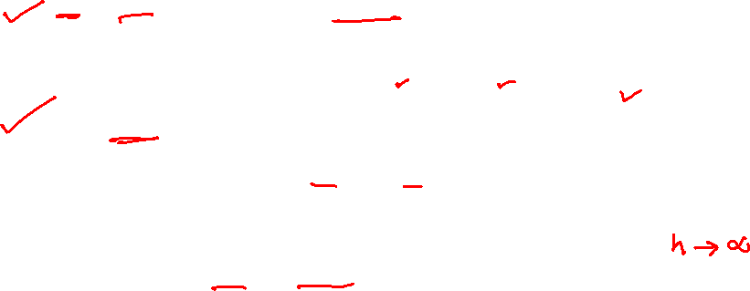
Measures of Dis/similarity Distances : Special Cases of Minkowski
h = 1: Manhattan (city block, L₁ norm) distance
E.g., the Hamming distance: the number of bits that are different between two binary vectors
h = 2: (L₂ norm) Euclidean distance
h → ∞. “supremum” (L_{max} norm, L∞ norm) distance.
This is the maximum difference between any component (attribute) of the vectors

Slide 16
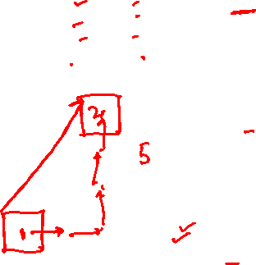
Example: Minkowski Distance
(Dissimilarity Matrices)
Manhattan (L₁)
Euclidean (L₂)
Supremum

Slide 17
Standardizing Numeric Data
Z-score:
X: raw score to be standardized, μ: mean of the population, σ: standard deviation
the distance between the raw score and the population mean in units of the standard deviation
negative when the raw score is below the mean, “+” when above
Where

Slide 18
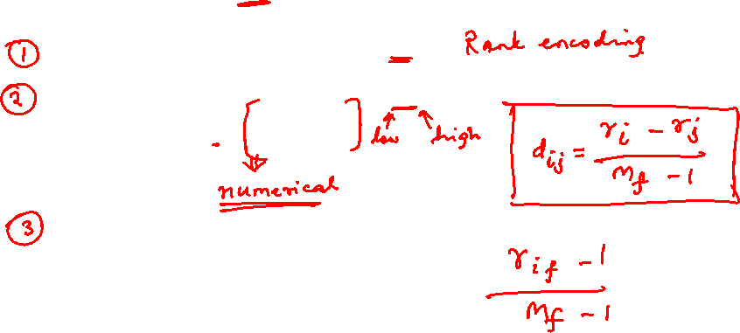
Measures of Dis/similarity : Ordinal Variables
An ordinal variable can be discrete or continuous
Order is important, e.g., rank
Can be treated like interval-scaled
replace x_{if} by their rank
map the range of each variable onto [0, 1] by replacing i-th object in the f-th variable by
compute the dissimilarity using methods for interval-scaled variables

Slide 19
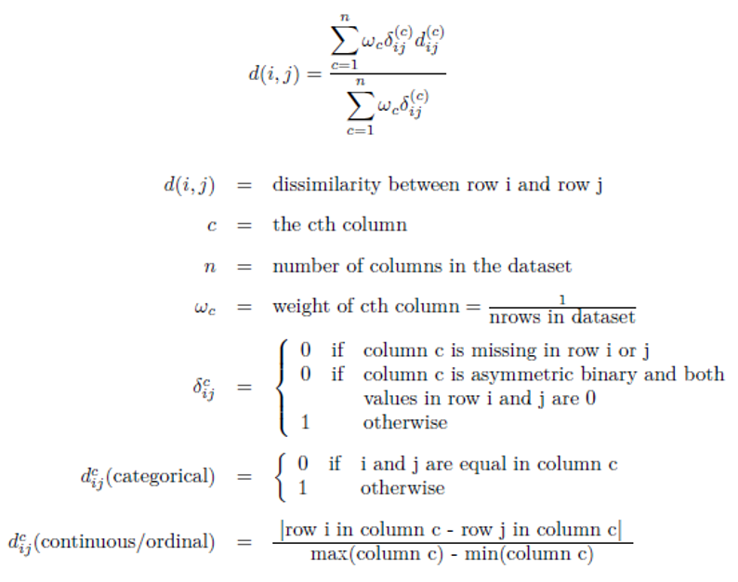
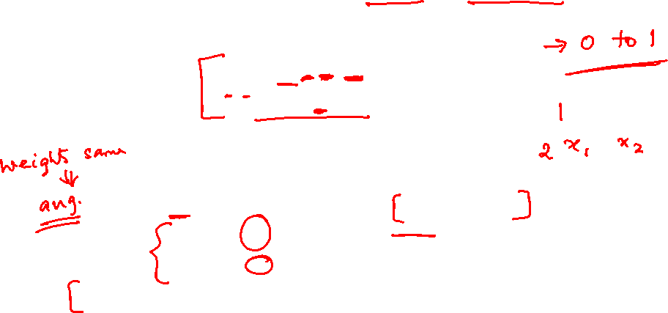
Measures of Dis/similarity Attributes of Mixed Type: Gower distance
A database may contain all attribute types
Nominal, symmetric binary, asymmetric binary, numeric, ordinal
https://healthcare.ai/clustering-non-continuous-variables/

Slide 20
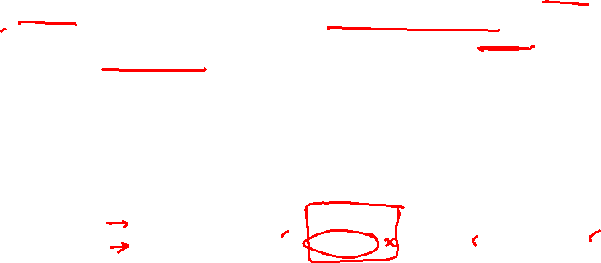
Example
Based on the information given in the table below, find most similar and most dissimilar persons among them. Apply min-max normalization on income to obtain [0,1] range. Consider profession and mother tongue as nominal. Consider native place as ordinal variable with ranking order of [Village, Small Town, Suburban, Metropolitan]. Give equal weight to each attribute.
Name | Income | Profession | Mother tongue | Native Place
Ram | 70000 | Doctor | Bengali | Village
Balram | 50000 | Data Scientist | Hindi | Small Town
Bharat | 60000 | Carpenter | Hindi | Suburban
Kishan | 80000 | Doctor | Bhojpuri | Metropolitan

Slide 21
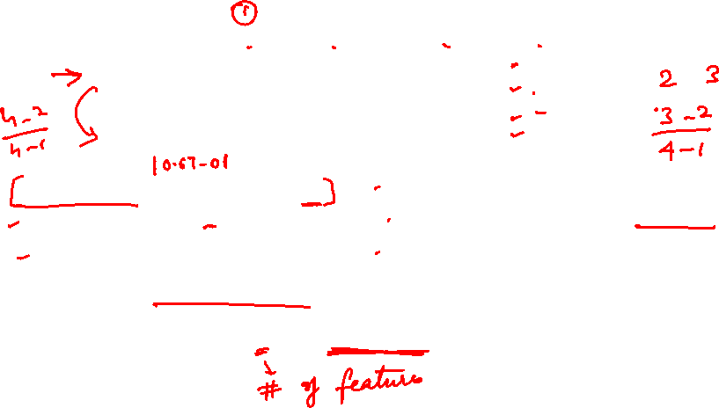
Solution
After normalizing income and quantifying native place, we get
d(Ram, Balram) = 0.67+1+1+(2-1)/(4-1)=3 d(Ram, Bharat) = 0.33+1+1+(3-1)/(4-1)=3
d(Ram, Kishan) = 0.33+0+1+(4-1)/(4-1) = 2.33 d(Balram, Bharat) = 0.33+1+0+(3-2)/(4-1)=1.67
d(Balram, Kishan) = 1+1+1+(4-2)/(4-1) = 3.67 d(Bharat, Kishan) = 0.67+1+1+(4-3)/(4-1) = 3
Most similar – Balram and Bharat; Most dissimilar – Balram and Kishan
Gower’s Distance = d(i,j) / 4 (with equal weights it becomes simple average)
It will range from 0 to 1.
Name | Income | Profession | Mother tongue | Native Place
Ram | 0.67 | Doctor | Bengali | 1
Balram | 0 | Data Scientist | Hindi | 2
Bharat | 0.33 | Carpenter | Hindi | 3
Kishan | 1 | Doctor | Bhojpuri | 4

Slide 22
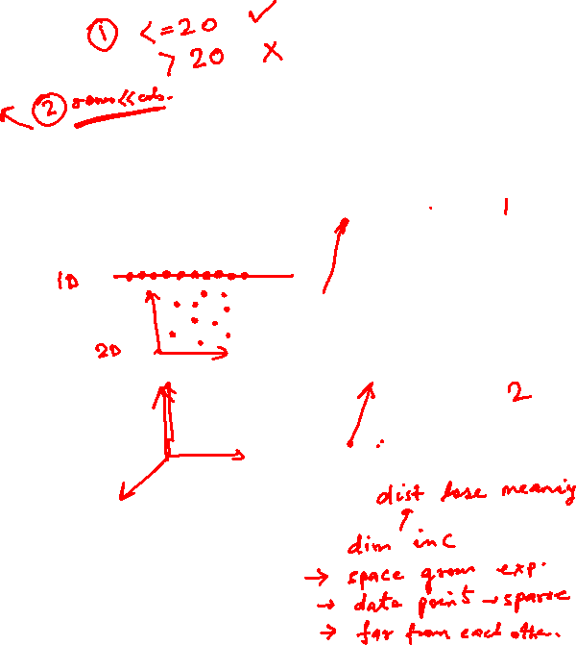
Measures of Dis/similarity Curse of Dimensionality
Stretching the axes in the Euclidean space, shortening the axes that correspond to less relevant attributes, and lengthening the axes that correspond to more relevant attributes
It uses all attributes to classify instances
If the target concept depends on only a few of the many available attributes, then the instances that are truly most "similar" may well be a large distance apart.
Curse of dimensionality: nearest neighbor is easily misled when instance space is high-dimensional
Solution 1: weigh the attributes differently (use cross-validation to determine the weights)
Solution 2: eliminate the least relevant attributes (again, use cross-validation to determine which attributes to eliminate)

Slide 23
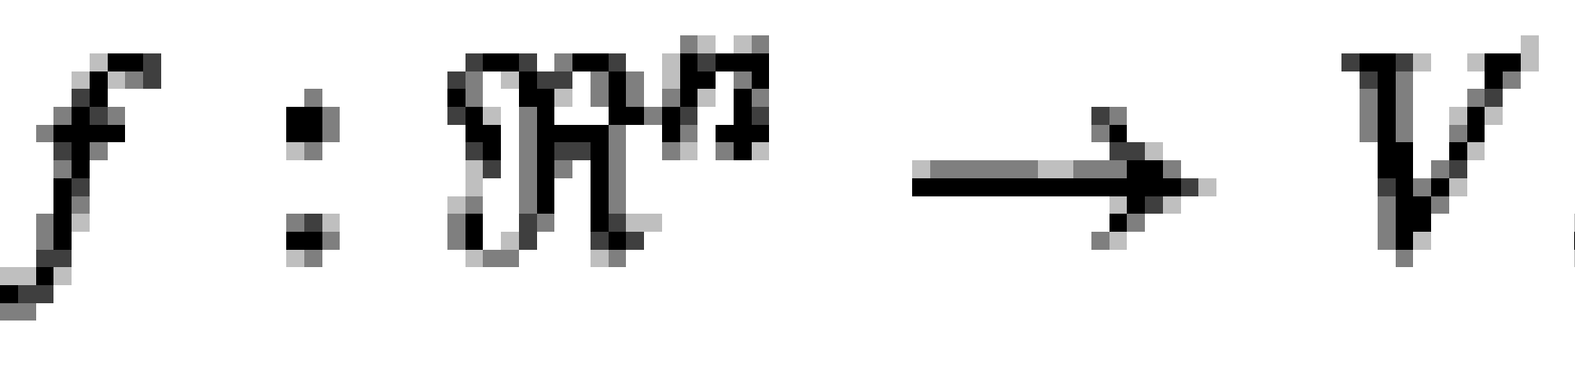
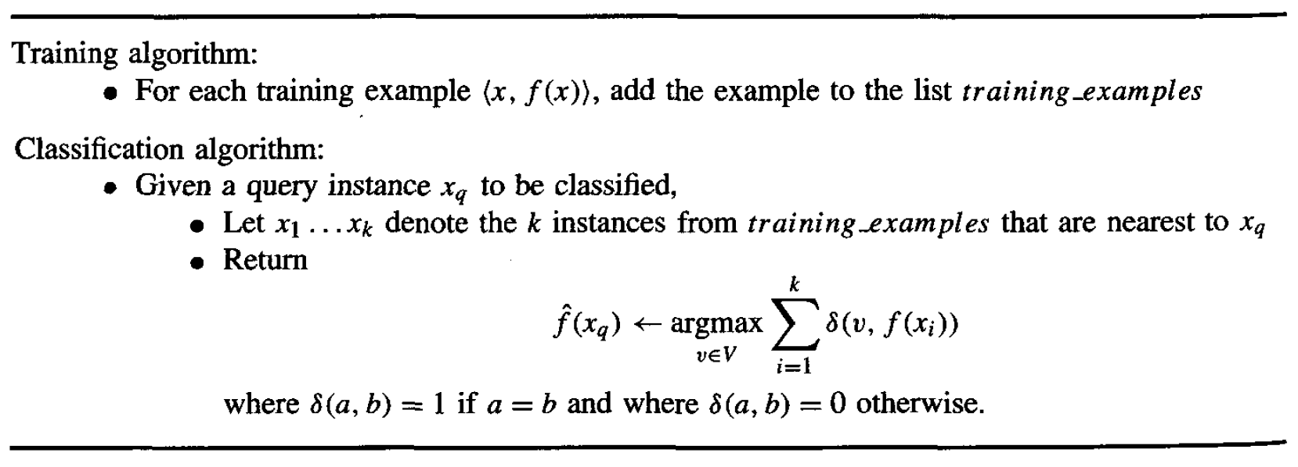

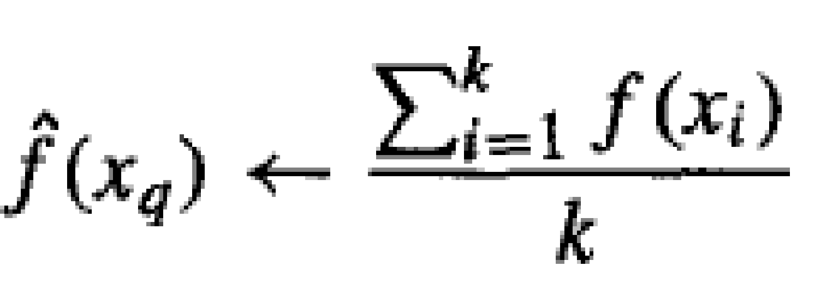
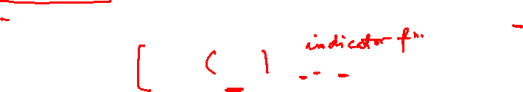
Instance Based Learning
K-Nearest Neighbor : Algorithm
Approximating a discrete-valued function
Approximate a real-valued target function

Slide 24

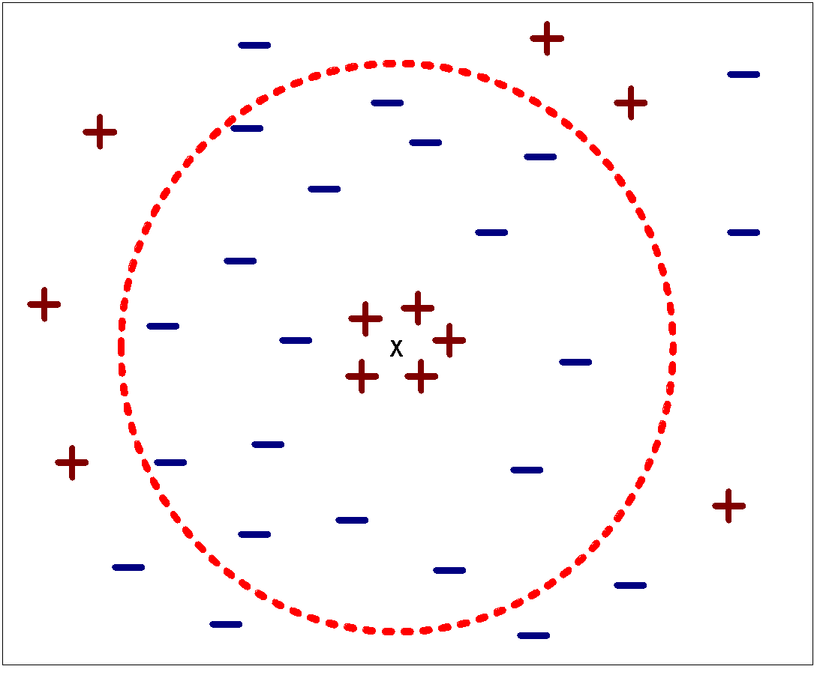
Instance Based Learning
K-Nearest Neighbor : Hyper parameter “K”
Choosing the value of k:
Rule of thumb:
K = sqrt(N)
N: number of training points

Slide 25
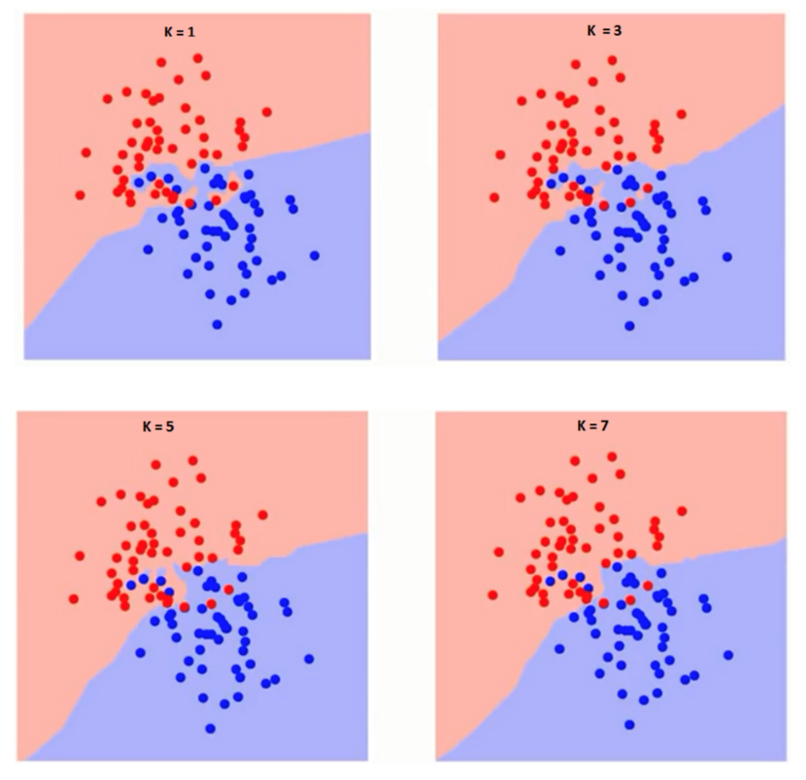
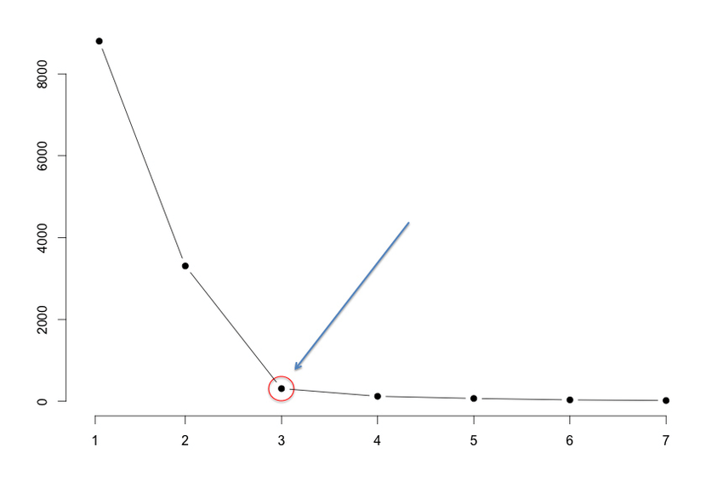
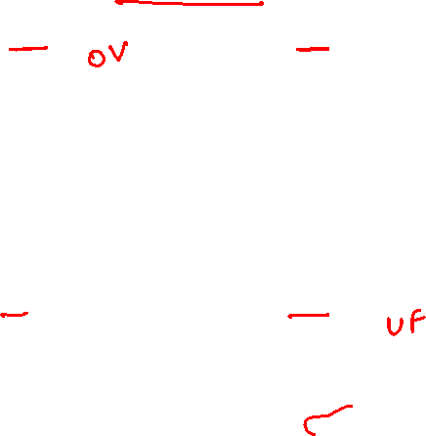
Instance Based Learning
K-Nearest Neighbor : Hyper parameter “K” : Elbow Method
Compute sum of squares error (SSE) or any other error function for varying values of K (1 to a reasonable X) and plot against K
In the plot, the elbow (see pic) gives the value of K beyond which the error function plot almost flattens
As K approaches the total number of instances in the set, error function drops down to ‘0’
Error function (SSE)
K value

Slide 26
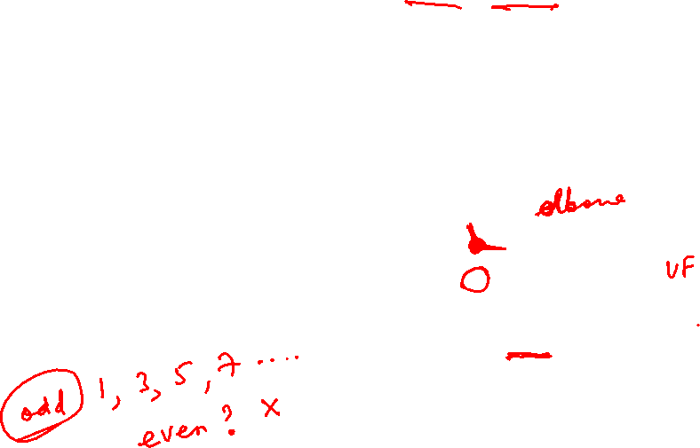
Instance Based Learning
K-Nearest Neighbor : Hyper parameter “K” : Elbow Method
Compute sum of squares error (SSE) or any other error function for varying values of K (1 to a reasonable X) and plot against K
In the plot, the elbow (see pic) gives the value of K beyond which the error function plot almost flattens
As K approaches the total number of instances in the set, error function drops down to ‘0’
Error function (SSE)
K value

Slide 27
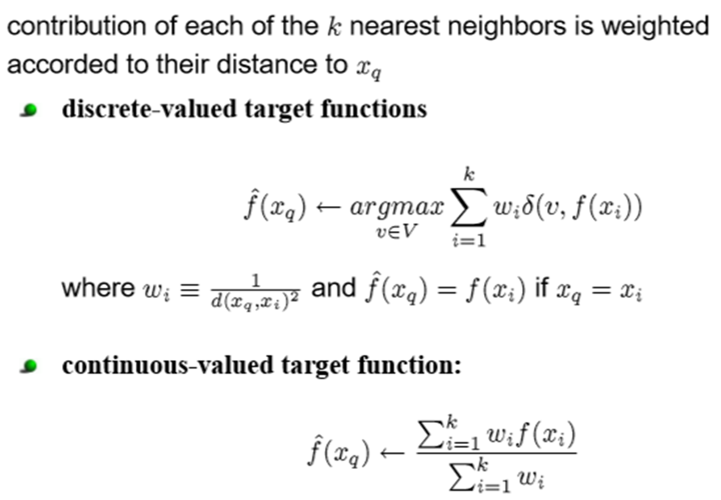
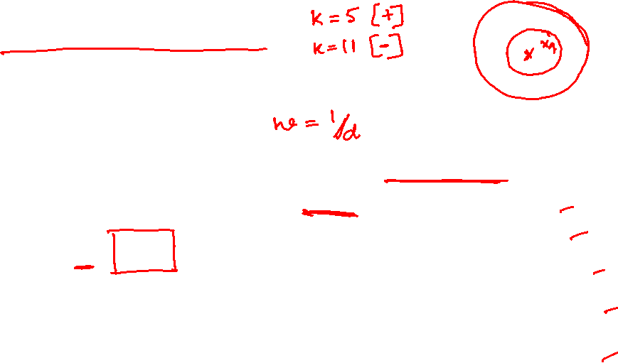
Instance Based Learning
K-Nearest Neighbor : Variation
Distance Weighted K-NN algorithm
Kernel Functions
w_{i}=K(d(x_{q},x_{i}))
K(d(x_{q},x_{i})) = 1/ d(x_{q},x_{i})²
K(d(x_{q},x_{i})) = 1/(d₀+d(x_{q},x_{i}))²
K(d(x_{q},x_{i})) = exp(-(d(x_{q},x_{i})/σ₀)²)
d(x_{q},x_{i}) is the distance between x_{q} and x_{i}

Slide 28
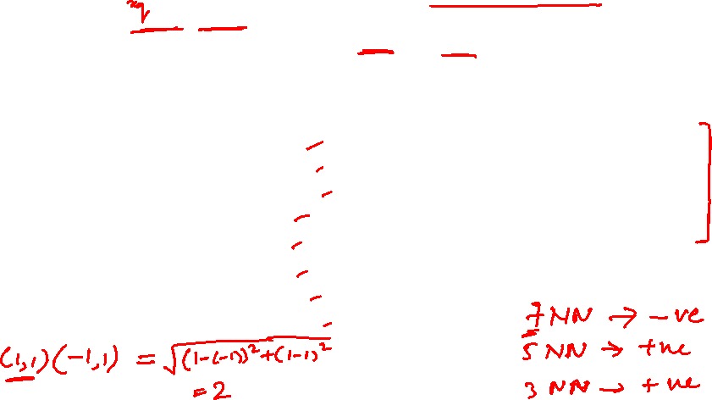
Problem Type – 1
Consider the following training set in 2-dimensional Euclidean space. What is the class of the point (1, 1) if 7NN classifier is considered? If the value of K is reduced whether the class will change? (Consider K=3 and K=5). What should be the final class if the above 3 values of K are considered?
Point | Distance | Class
X2 | 1 | Positive
X5 | 1 | Positive
X6 | 1 | Positive
Point | Coordinate | Class
X1 | (-1, 1) | Negative
X2 | (0, 1) | Positive
X3 | (0, 2) | Negative
X4 | (1, -1) | Negative
X5 | (1, 0) | Positive
X6 | (1, 2) | Positive
X7 | (2, 2) | Negative
X8 | (2, 3) | Positive
Distance from (1,1)
2
1
1.414
2
1
1
1.41
2.236
Point | Distance | Class
X2 | 1 | Positive
X5 | 1 | Positive
X6 | 1 | Positive
X7 | 1.41 | Negative
X3 | 1.414 | Negative
X1 | 2 | Negative
X4 | 2 | Negative
Point | Distance | Class
X2 | 1 | Positive
X5 | 1 | Positive
X6 | 1 | Positive
X7 | 1.41 | Negative
X3 | 1.414 | Negative

Slide 29
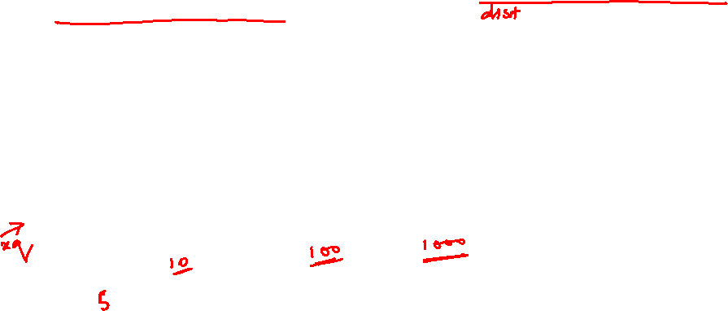
Problem Type – 2
Based on the information given in the table below, find the customer type of x_{q}=C4 using K-NN. In given example consider all the instances and use locally weighted K-NN algorithm with kernel K(d(x_{q},x_{i})) = 1/ d(x_{q},x_{i})².
Apply min-max normalization on income to obtain [0,1] range. Consider profession and Region as nominal. Consider :Locality as ordinal variable with ranking order of [Village, Small Town, Suburban, Metropolitan]. Give equal weight to each attribute.
Customer | Income | Profession | Region | Locality | Category
C0 | 60000 | Doctor | Hindi | Village | L1
C1 | 70000 | Doctor | Bengali | Village | L2
C2 | 60000 | Carpenter | Hindi | Suburban | L2
C3 | 80000 | Doctor | Bhojpuri | Metropolitan | L2
C5 | 80000 | Data Scientist | Hindi | Small Town | L1
C4 | 50000 | Data Scientist | Hindi | Small Town

Slide 30
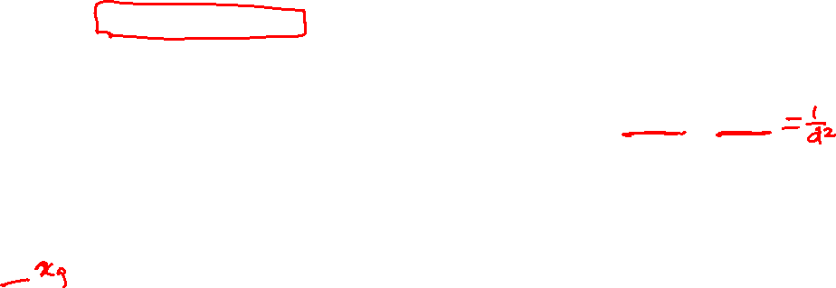
Problem Type – 2
Based on the information given in the table below, find the customer type of x_{q}=C4 using K-NN. In given example consider all the instances and use locally weighted K-NN algorithm with kernel K(d(x_{q},x_{i})) = 1/ d(x_{q},x_{i})².
Apply min-max normalization on income to obtain [0,1] range. Consider profession and Region as nominal. Consider :Locality as ordinal variable with ranking order of [Village, Small Town, Suburban, Metropolitan]. Give equal weight to each attribute.
Customer | Income | Profession | Region | Scaled Locality | Category
C0 | 0.33 | Doctor | Hindi | 1 🡪 0 | L1
C1 | 0.67 | Doctor | Bengali | 1 🡪 0 | L2
C2 | 0.33 | Carpenter | Hindi | 3 🡪 0.67 | L2
C3 | 1 | Doctor | Bhojpuri | 4 🡪 1 | L2
C5 | 1 | Data Scientist | Hindi | 2 🡪 0.33 | L1
C4 | 0 | Data Scientist | Hindi | 2 🡪 0.33
Distance | Weight
0.97 | 1.06
1.75 | 0.33
0.97 | 1.06
2.2 | 0.21
1 | 1
0 (NA)
d(C4, C2)
= distance w.r.t to numerical attributes + distance w.r.t Nominal attributes
= Euclidean distance on (Income, Scaled Locality ) + Categorical distance on attributes (Profession, Region)
= √((Income_{c4-}Income_{c2)}^{"2}" +( Locality_{c4-}Locaility_{c2)}² )+(No.of.Categorical features -No.of.Matches between C4 & C2)/(No.of.Categorical Features)
= √((0-0.33)^{"2}" +( 0.33-0.67)² )+(2 -1)/2
= 0.47 + 0.5 = 0.97

Slide 31

Problem Type – 2
Based on the information given in the table below, find the customer type of x_{q}=C4 using K-NN. In given example consider all the instances and use locally weighted K-NN algorithm with kernel K(d(x_{q},x_{i})) = 1/ d(x_{q},x_{i})².
Apply min-max normalization on income to obtain [0,1] range. Consider profession and Region as nominal. Consider :Locality as ordinal variable with ranking order of [Village, Small Town, Suburban, Metropolitan]. Give equal weight to each attribute.
Customer | Income | Profession | Region | Scaled Locality | Category
C0 | 0.33 | Doctor | Hindi | 1 🡪 0 | L1
C1 | 0.67 | Doctor | Bengali | 1 🡪 0 | L2
C2 | 0.33 | Carpenter | Hindi | 3 🡪 0.67 | L2
C3 | 1 | Doctor | Bhojpuri | 4 🡪 1 | L2
C5 | 1 | Data Scientist | Hindi | 2 🡪 0.33 | L1
C4 | 0 | Data Scientist | Hindi | 2 🡪 0.33
Distance | Weight
0.97 | 1.06
1.75 | 0.33
0.97 | 1.06
2.2 | 0.21
1 | 1
0 (NA)
Point | Kernel / Weight | Class
C5 | 1 | L1
C0 | 1.06 | L1
C2 | 1.06 | L2
C1 | 0.33 | L2
C3 | 0.21 | L2
Inference : Without weighted KNN, L2 is the majority voted class.
But with weighted distances, L1 class instances are more similar to C4

Slide 32
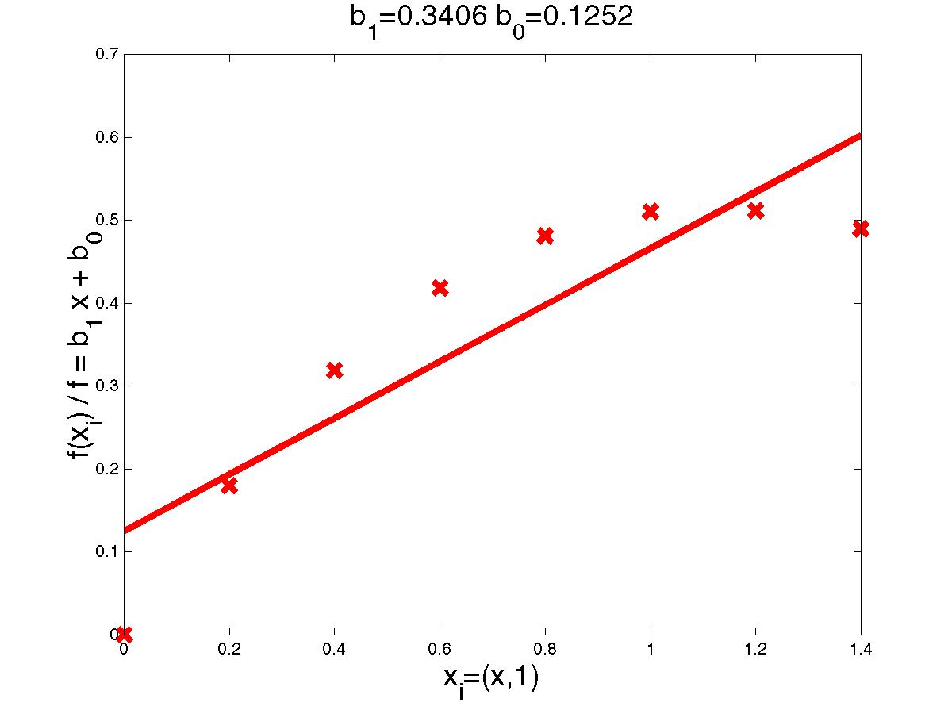
Locally Weighted Regression

Slide 33
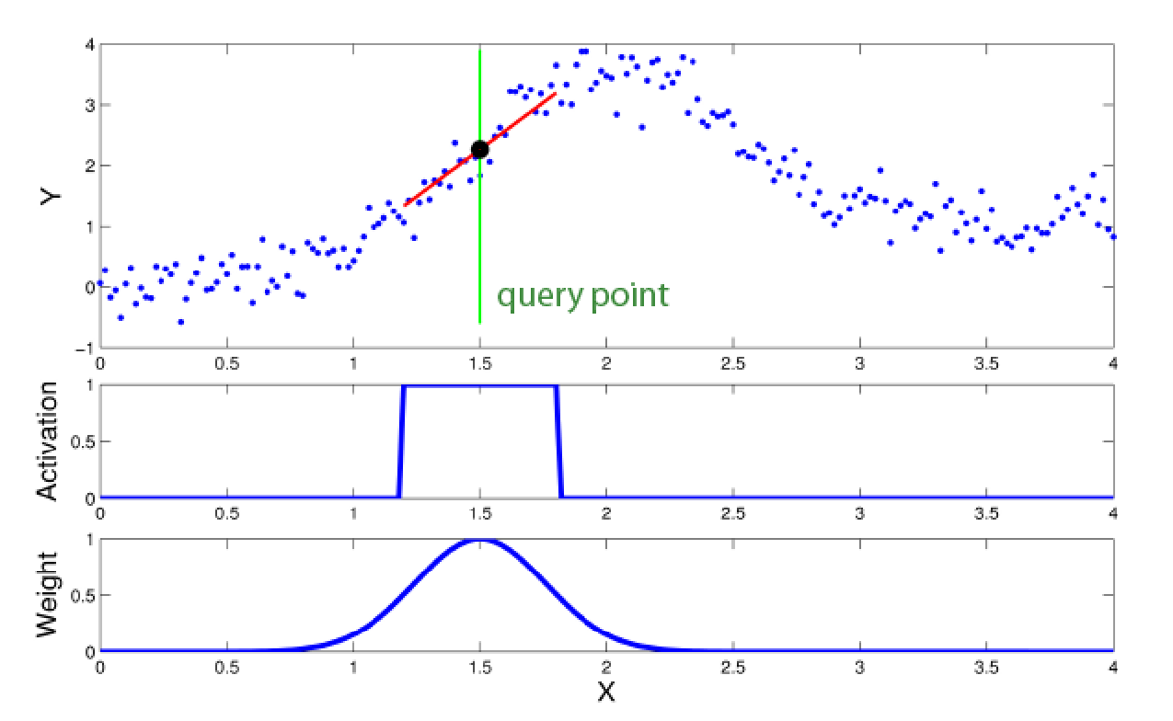

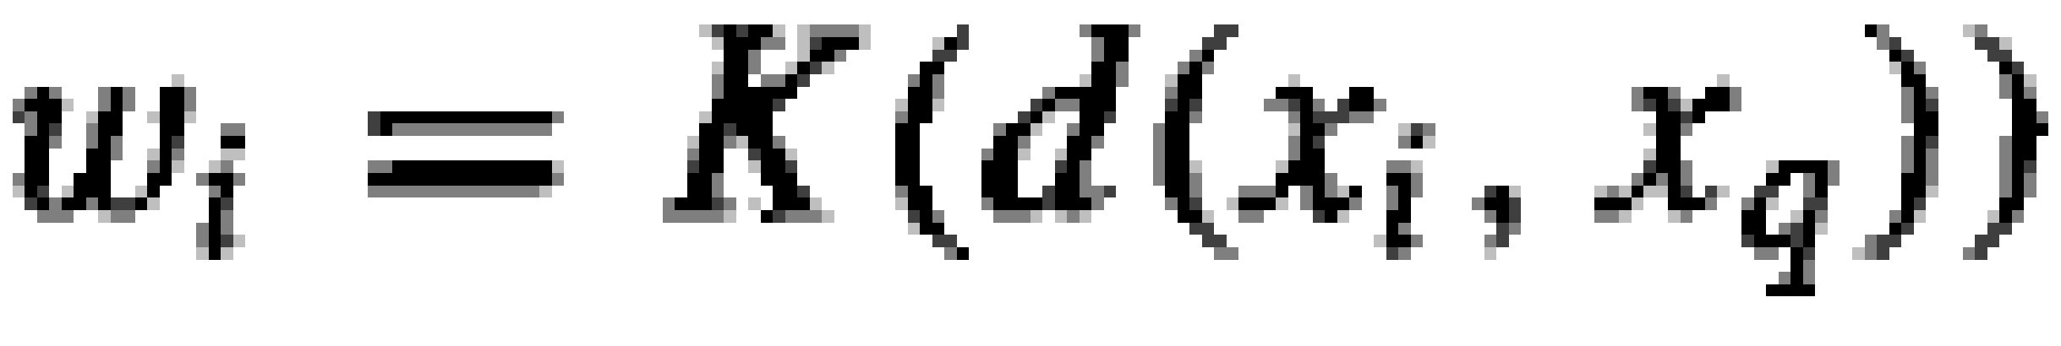
Locally Weighted Regression
Locally – Function approximated based on data near query point
Weighted – Contribution by each training example is weighted by its distance from query point
Regression- Approximates real-valued target function
Residual is the error in approximating the target function.
Kernel function is the function of distance that is used to determine the weight of each training example. In other words, the kernel function is the function K such that
Source Credit : https://www.ias.informatik.tu-darmstadt.de/uploads/Teaching/AutonomousLearningSystems/Englert_ALS_2012.pdf

Slide 34
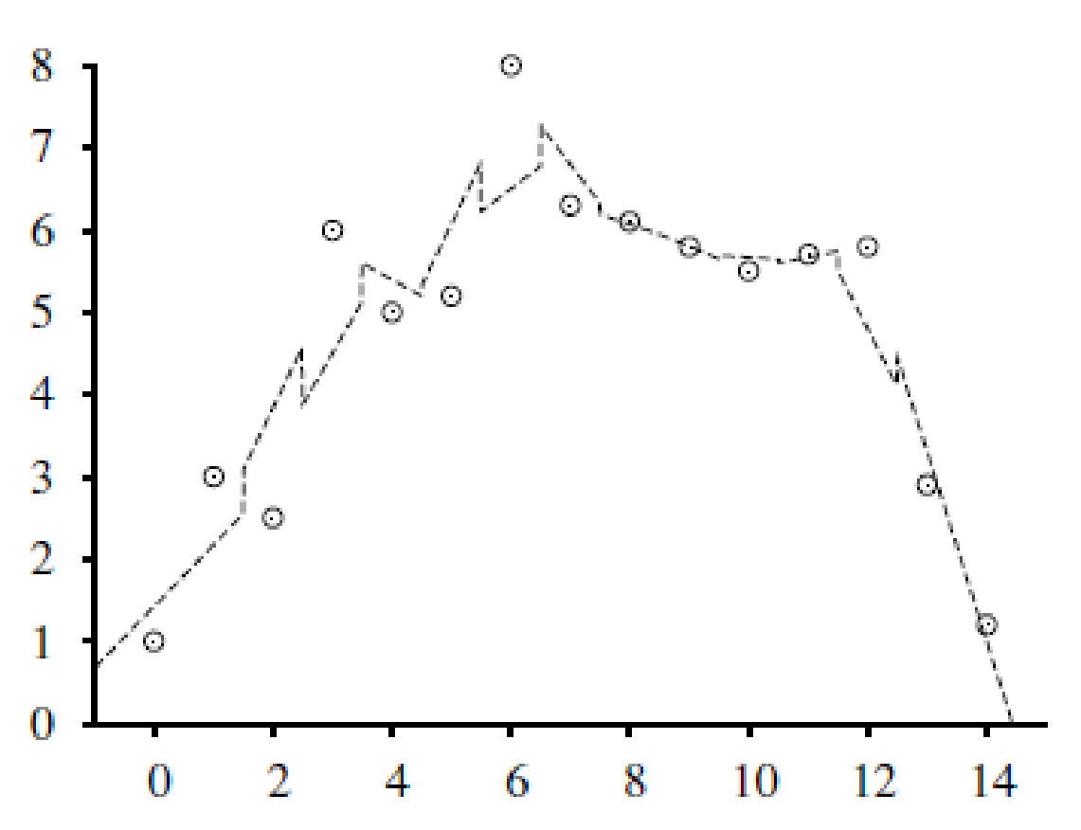
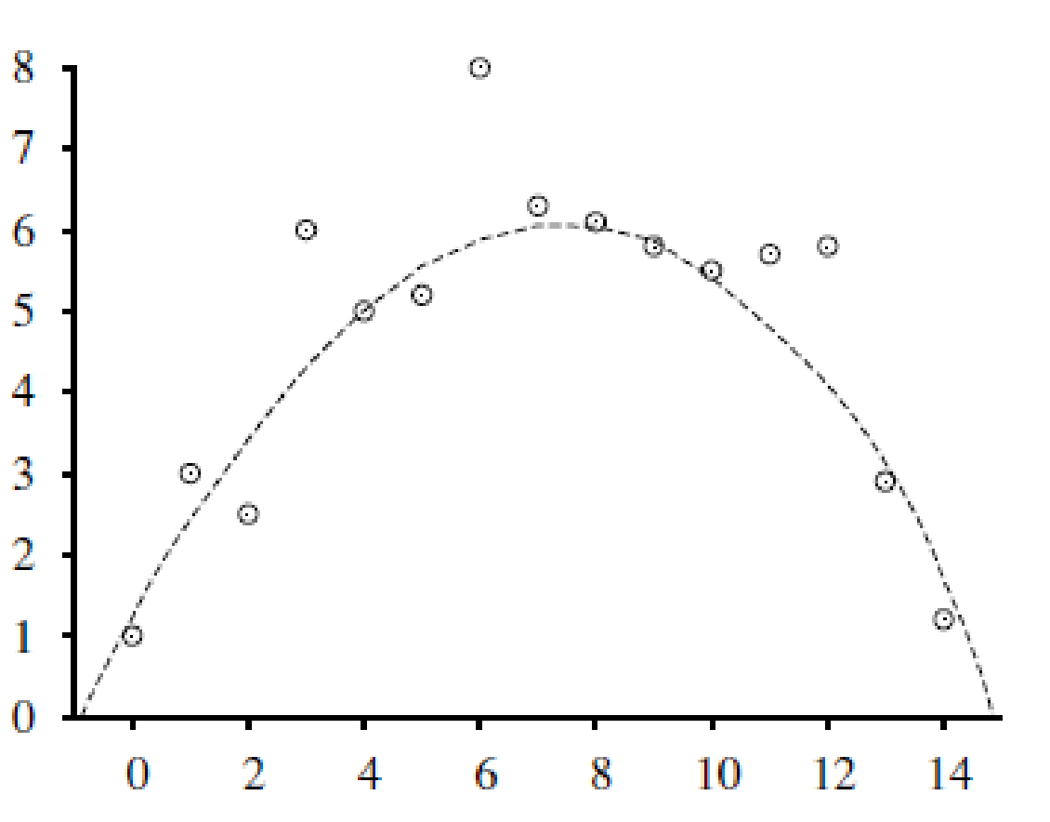
Locally Weighted Regression
3-nearest-neighbors linear regression
The nearest-neighbor approaches can be thought of as approximating the target function f (x) at the single query point x = x_{q}
Locally weighted regression is a generalization of this approach. It constructs an explicit approximation to f over a local region surrounding x_{q}
Approximate the target function in the neighborhood surrounding x, using a linear function, a quadratic function, a multilayer neural network, or some other functional form.
Locally weighted regression with
a quadratic kernel

Slide 35
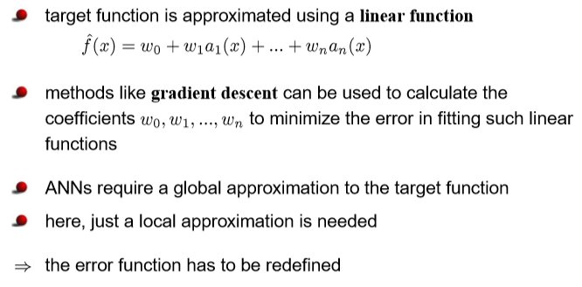
Locally weighted linear regression

Slide 36
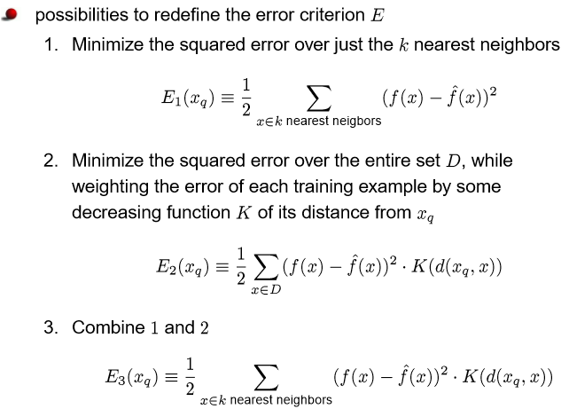
Locally weighted linear regression

Slide 37
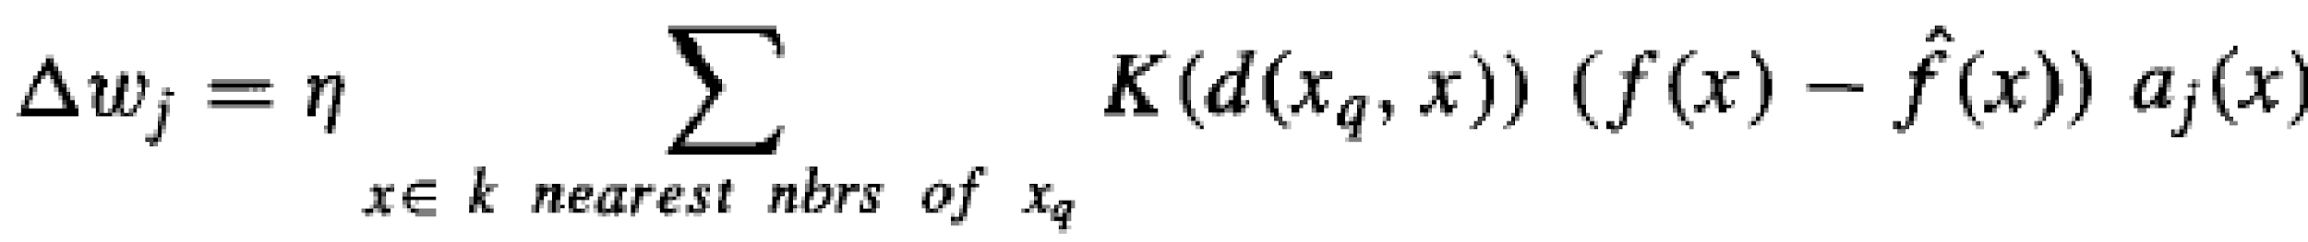
Locally weighted linear regression
For a given query point x_{q} we solve the following weighted regression problem using gradient descent training rule:
Note that we need to solve a new regression problem for every query point—that’s what it means to be local.
In ordinary linear regression, we solved the regression problem once, globally, and then used the same h_{w} for any query point.
Note: + sign in weight update rule as in Δw_{i} (actual-prediction ) is used.
If we use (prediction – actual) then instead of ‘+’, ‘-’ sign will be used.

Slide 38
Example
The upper graphic the set of data points (x,y) (blue dots), query point (green line), local linear model (red line) and prediction (black dot).
The graphic in the middle shows the activation area of the model.
The corresponding weighting kernel (receptive field) is shown in the bottom graphic.
Source Credit : https://www.ias.informatik.tu-darmstadt.de/uploads/Teaching/AutonomousLearningSystems/Englert_ALS_2012.pdf

Slide 39
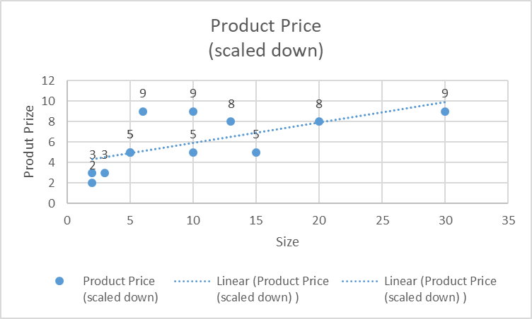
Problem Type - 3
Consider the following training set in 2-dimensional Euclidean space. What is the prize of the product with size 7 if 5-NN is considered? Use the kernel of the form K(d(x_{q},x_{i})) = exp( - d(x_{q},x_{i})² / 2b²) where b=1. Use the linear regression of the form y = 3.5 + 0.8 x and the learning rate of 0.2 to apply the gradient descent and update the weights at the end of first iteration
Size | Product Price (scaled down)
10 | 5
5 | 5
2 | 2
3 | 3
5 | 5
15 | 5
30 | 9
20 | 8
6 | 9
2 | 3
10 | 9
13 | 8

Slide 40
Problem Type - 3
Consider the following training set in 2-dimensional Euclidean space. What is the prize of the product with size 7 if 5-NN is considered? Use the kernel of the form K(d(x_{q},x_{i})) = exp( - d(x_{q},x_{i})² / 2b²) where b=1. Use the linear regression of the form y = 3.5 + 0.8 x and the learning rate of 0.2 to apply the gradient descent and update the weights at the end of first iteration
Size | Product Price (scaled down)
10 | 5
5 | 5
2 | 2
3 | 3
5 | 5
15 | 5
30 | 9
20 | 8
6 | 9
2 | 3
10 | 9
13 | 8

Slide 41


Problem Type - 3
Size | Product Price (scaled down) | d(xq, xi) | K(d(x_{q},x_{i}))
10 | 5 | 3 | 0.01
5 | 5 | 2 | 0.14
2 | 2 | 5 | 0
3 | 3 | 4 | 0
5 | 5 | 2 | 0.14
15 | 5 | 8 | 0
30 | 9 | 23 | 0
20 | 8 | 13 | 0
6 | 9 | 1 | 0.61
2 | 3 | 5 | 0
10 | 9 | 3 | 0.01
13 | 8 | 6 | 0
Apply gradient descent where the gradient is weighed by the kernel output.
Answer :
Updated weights after 1st iteration
w0 = 3.43, w1= 0.43

Slide 42
When to Consider Nearest Neighbors
Suitable for Low dimensional datasets
Local information can yield highly adaptive behavior
Lots of training data (distance-weighted KNN)
Training is very fast
Learn complex target functions
Do not lose information
Noisy training data (distance-weighted KNN)
by taking the weighted average of the k neighbors nearest to the query point, it can smooth out the impact of isolated noisy training examples.

Slide 43
Nearest-Neighbor Classifiers: Challenges
The value of k, the number of nearest neighbors to retrieve
Choice of Distance Metric to compute distance between records
Expensive, Slow at query time
To determine the nearest neighbour of a query point q, must compute the distance to all N training examples
Pre-sort training examples into fast data structures (kd-trees)
Remove redundant data (condensing)
Storage Requirements
Must store all training data P
Remove redundant data (condensing)

Slide 44
Additional Exercise for Students
Consider the following training set in 2-dimensional Euclidean space. What is the prize of the product with size 12 if 7-NN is considered? Use the kernel of the form K(d(x_{q},x_{i})) = 1/ d(x_{q},x_{i})². Use the linear regression of the form y = 2 + 1.5 x and the learning rate of 0.6 to apply the gradient descent and update the weights at the end of first iteration. Use Manhattan Distance for the distance calculation.
Try to scale all the features with min-max of [0-5] and redo the modelling under previous question. Observe to Interpret the influence of the scaling
Find the MSE of the K-NNs from the results of both above parts separately & state your observations
If the Product with features (13,6) and (30,4) are outliers then interpret the effect of the same in the K-NN modelling, before and after removing them with numerical justication.
Size | Rating (1-10) | Product Price (scaled down)
10 | 5 | 5
5 | 2 | 5
2 | 7 | 2
3 | 6 | 3
5 | 4 | 5
15 | 8 | 5
30 | 4 | 9
20 | 8 | 8
6 | 10 | 9
2 | 2 | 3
10 | 4 | 9
13 | 6 | 8

Slide 45
Lab : Practise :
Take any BITS virtual Lab dataset and experiment on below cases
Tune KNN. Try different values of k to see if you can improve the performance of the algorithm.
Use weighted KNN and check the performance
Regression. Apply it to a regression predictive modelling problem (e.g. predict a numerical value)
More Distance Measures. Implement other distance measures such as Hamming distance, Manhattan distance and Minkowski distance.
Data Preparation. Distance measures are strongly affected by the scale of the input data. Experiment with and without standardization and other data preparation methods in order to improve results.

Slide 46
Evaluating Classifier Performance

Slide 47
Model selection and assessment
Model selection: estimating the performance of different models in order to choose the best one.
Model assessment: having chosen a final model, estimating its prediction error (generalization error) on new data.
To estimate generalization error (measure the quality of inductive bias), we need data unseen during training. We split the data as
Training set : used to fit the models
Validation set : used to estimate prediction error for model selection, tune hyperparameters, feature selection
Test (publication) set : is used for assessment of the generalization error of the final chosen model

Slide 48
Hyper parameter tuning using test set
Supervised data
Problem 1: Hesitating between two models (e.g linear model and a polynomial model) ?
Solution 1: train both and compare how well they generalize using the test set: linear model generalizes better but looks like overfitting So, apply some regularization
Problem 2: how to choose the value of regularization hyper parameter?
Solution 2: train 100 different models using 100 different values for this hyper parameter. Choose best hyper parameter value with the lowest generalization error (5%). Great!!!: launch into production
+
Training set
+
-
-
+
Model Builder
(Re-train?)
Predictions
+
-
+
-
Y
N
Evaluate
Testing set
Problem 3: Error now is increased to 5% errors. Why?
Answer 3: Generalization error was measured multiple times on the test set, So model and hyper parameters are adapted to produce the best model for that particular set, unlikely to perform as well on new data.
Learning : The test data can’t be used for parameter tuning!

Slide 49
Train, Validation, Test split
Holdout validation (holdout or development, or dev set)
Train multiple models with various hyper parameters on the reduced training set (i.e., the full training set minus the validation set)
Select the model that performs best on the validation set
After this holdout validation process, you train the best model on the full training set (including the validation set), to get the final model.
Lastly, evaluate this final model on the test set to get an estimate of the generalization error
+
Training set
Model
Builder
+
-
-
Data
+
Evaluate
Model Builder
Predictions
+
-
+
-
Y
N
Validation set
+
-
+
-
Final Evaluation
Final Test Set
Final Model

Slide 50

Train-Test-Validation
https://www.kdnuggets.com/2017/08/dataiku-predictive-model-holdout-cross-validation.html

Slide 51

Making most out of the data
We don’t want to touch the test set until we are ready to launch a model we are confident about
If the validation set is too small, then model evaluations will be imprecise
Larger the validation data the more accurate the error estimate
If the validation set is too large, then the remaining training set will be much smaller than the full training set.
Larger the training data the better the classifier
Solution: cross validation

Slide 52




Cross-Validation techniques
Hold Out method
Leave One Out Cross-Validation
K-Fold Cross-Validation
Stratified K-Fold Cross-Validation
https://www.analyticsvidhya.com/blog/2021/05/4-ways-to-evaluate-your-machine-learning-model-cross-validation-techniques-with-python-code/

Slide 53

Cross-Validation for hyper parameter tuning
https://www.kdnuggets.com/2017/08/dataiku-predictive-model-holdout-cross-validation.html

Slide 54


Estimating generalization error : cross validation set Vs test set
Training set performance is not a good indicator of generalization error
A more complex model overfits, a less complex one underfits
Which model do I select?
Test set
Typically 80%, 20%
Wastes valuable labeled data
Cross validation
In Sklearn : cross_val_score() (default is accuracy)
cross_val_score will automatically split data into train and test
fit the model on train data
score on test data
For 10 folds, 10 scores will be returned in scores variable. Then take average of that

Slide 55
Thank you !
Required Reading for completed session :
T1 - Chapter # 8 (Tom M. Mitchell, Machine Learning)
Next Session Plan : Module 7 : Support vector machines will be covered in CS 15 or 16
Important Note for SVM : Below Math Pre-requisite (Yet to be discussed in MFML parallel course) :
Since the math basics will be covered in detail in math course, ML course is intended to discuss the application & interpretation of the model
Lagrange Multipliers
KKT – Conditions
Primal – Dual for SVM
Kernel for Non-Linear SVM

